Slide 1
Mushroom Classifiactin
Data Science Project​

Slide 2
AGENDA
Introduction​
Primary goals
Plan For Project Execution and Timeline
EDA
Model Building
Deployment
Summary​

Slide 3
Introduction
Mushroom is one of the fungi type food that has the most potent nutrients on the plants
Mushroom have major medical advantage such as killing cancer
This study aims to find the most appropriate technique for mushroom classification and mushroom will be classified into two categories, , Poisonous and edible

Slide 4
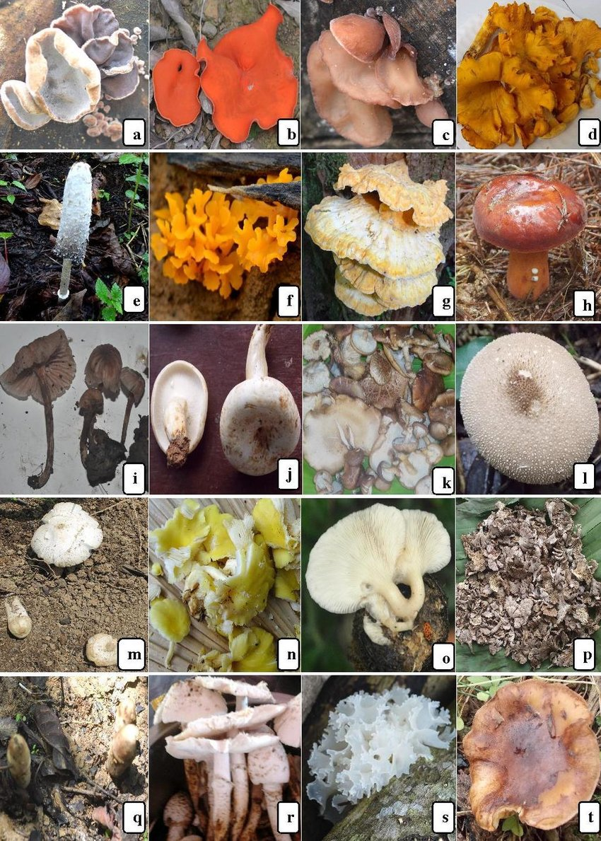
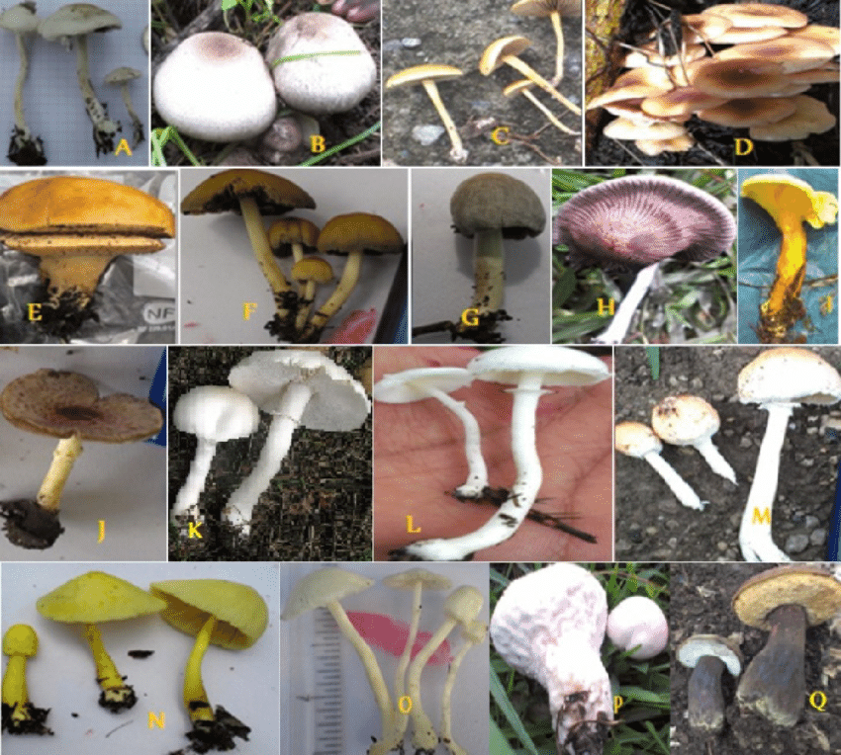
Edibale Mushrooms
Fig.1
Fig.2

Slide 5
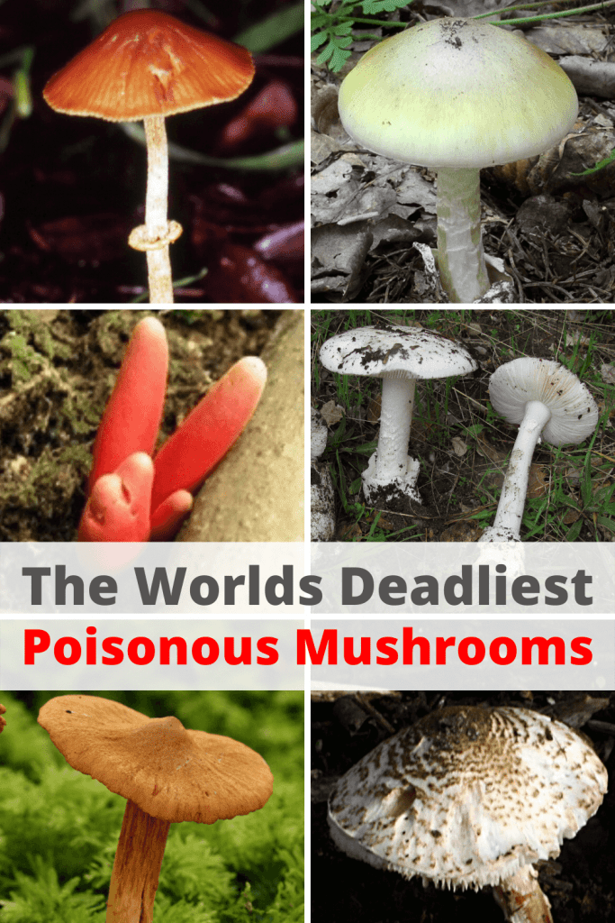
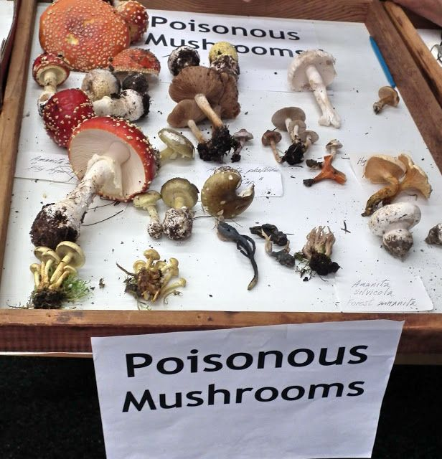
Poisonous Mushrooms
Fig.3
Fig.4

Slide 6
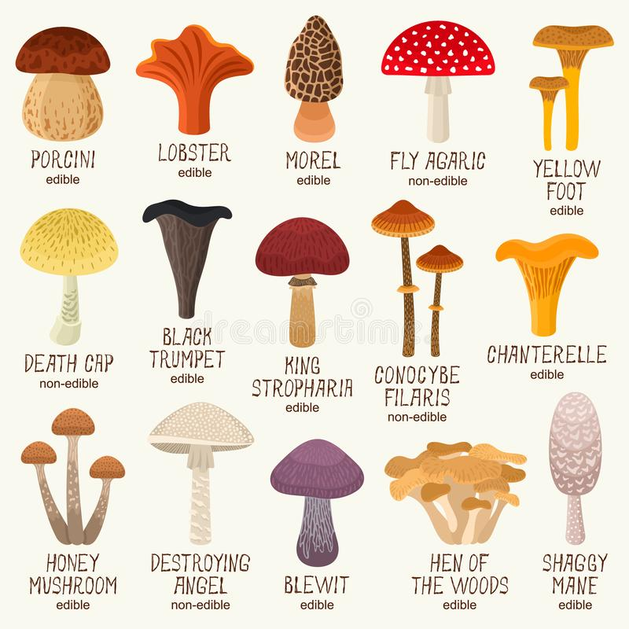
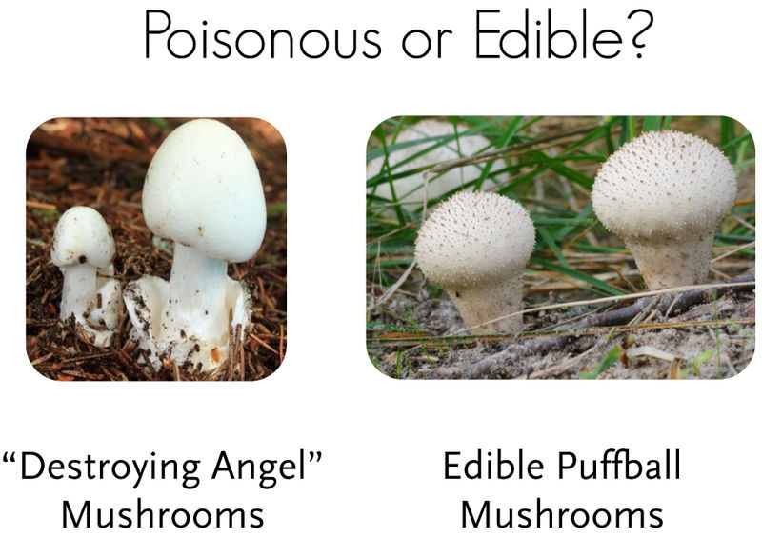
Mushrooms
Fig.5
Fig.6

Slide 7





PLAN FOR project execution
Row data
Basic step
visualization
Model building
deployment
Getting row data from client get information about the data
Checking primary requirement of client
Perform EDA to get the details from the data
Build the various classification model to get who's model fit and getting best accuracy
Deploy strategic model with compelling client needs

Slide 8
TIMELINE
Aug 3 week
Aug 4 week
Sep 1 week
Sep 2 week
Data Cleaning , Data Preprocessing , EDA
Various Model Building
Deployment with finalized Model
Presentation of Our work on Mushroom classification model

Slide 9
PRIMARY GOALS
This project aims at developing a machine-learning algorithm that will determine if a certain mushroom is edible or poisonous by its specifications like cap shape, cap color, gill color, etc. using different classifiers.
To do so, I have used the following classification methods:
Logistic Regressions
KNN
Support Vector Machine (SVM)
Decision Tree

Slide 10
EDA
Total count of
Edibale and Poisonous

Slide 11
Cap shape
Comparision b/w
cap-shape and class
Count plot of cap-shape based on class

Slide 12
Cap surface
Compariskion b/w
cap-surface and class
Count plot of
Cap surface on class

Slide 13
Cap - color
Comparison b/w
Cap color and class
Count plot of
Cap color on class

Slide 14
bruises
Comparison b/w
Bruises and class
Count plot of
Bruises on class

Slide 15
Gill-size
Comparison b/w
gill-size and class
Count plot of
Gill-size on class

Slide 16
Model Accuracy
Model | 0 | 1 | Accuracy | Macro Average | Weighted Average
Logistic Regression | 100 | 100 | 100 | 100 | 100
KNN | 99.88 | 99.87 | 99.88 | 99.88 | 99.88
SVM | 100 | 100 | 100 | 100 | 100
Decision Tree | 100 | 100 | 100 | 100 | 100
Random Forest | 100 | 100 | 100 | 100 | 100

Slide 17
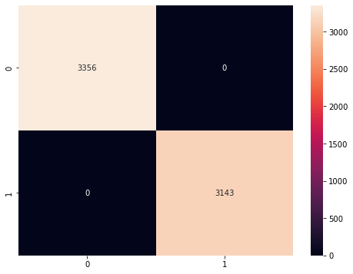
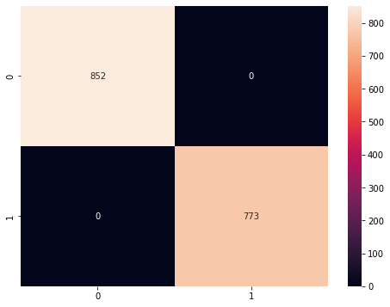
Logistic Regression Confusion Matrix
Training
Confusion matrix
Testing
Confusion matrix

Slide 18

k- nearest neighbors confusion matrix
Testing
Confusion matrix
Training
Confusion matrix

Slide 19
Support vector machine confuction matrix
Training
Confusion matrix
Testing
Confustion matrix

Slide 20
Decision tree

Slide 21
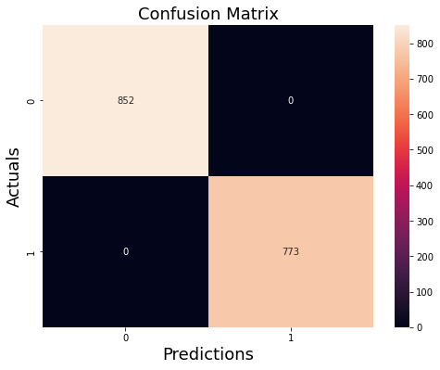
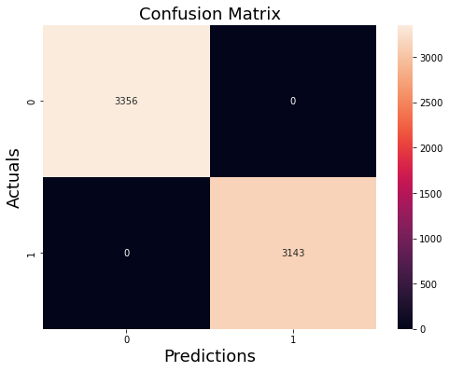
Decision tree confusion matrix
Training
Confusion matrix
Testing
confusion matrix

Slide 22
Deployment
After completed project aim to developed various machine-learning algorithm that will determine if a certain mushroom is edible or poisonous by its specifications like cap surface, bruises, cap color, gill size, etc. using different classifiers.
After getting accuracy from various model classification we decided to use following classification method for Deployment:
Decision Tree

Slide 23
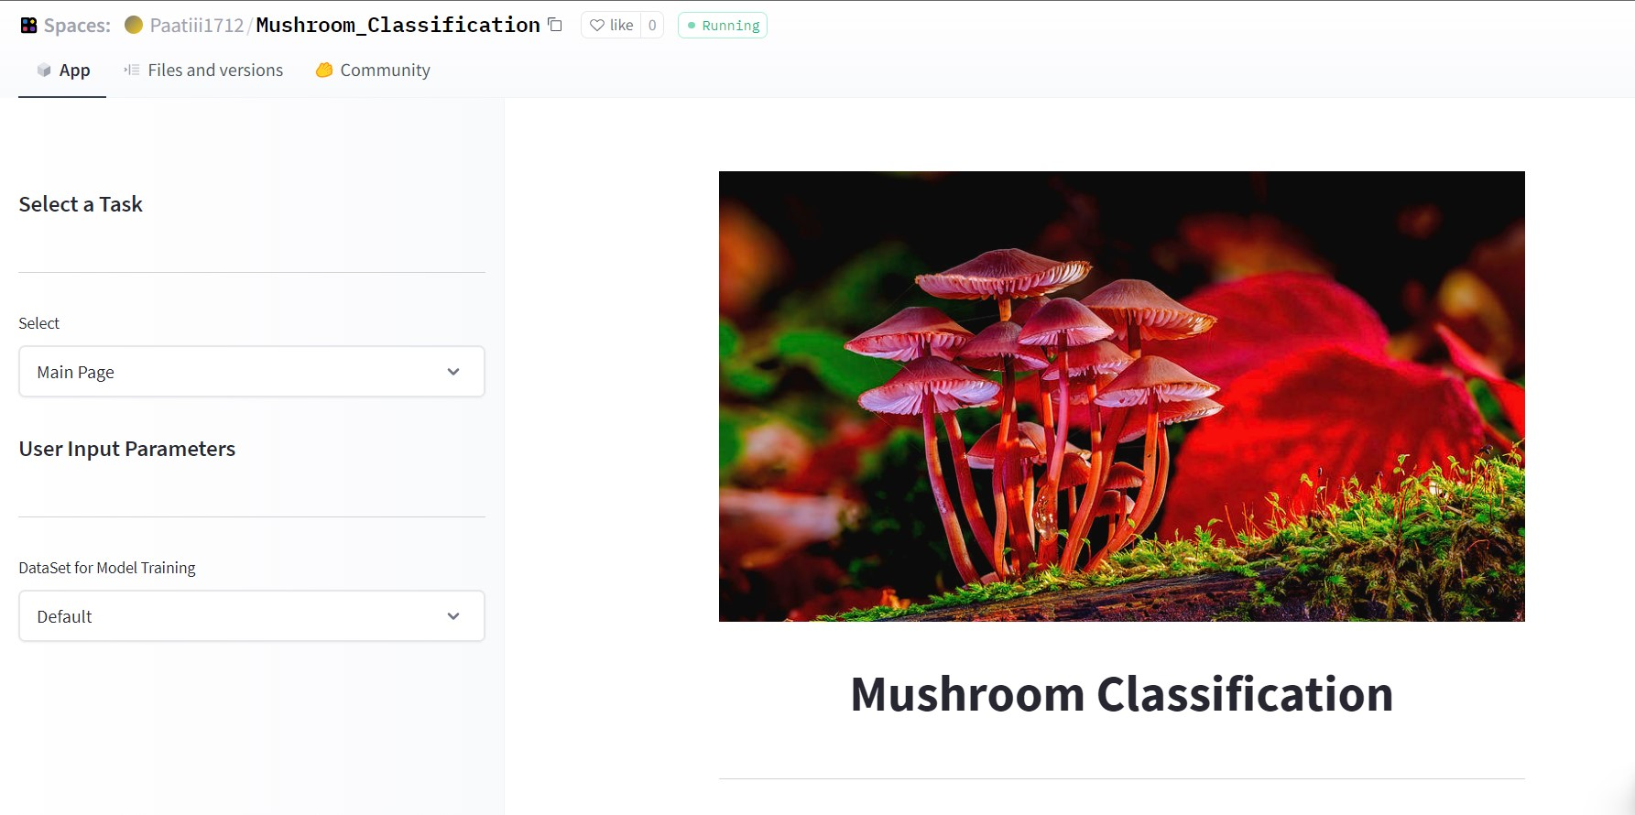
Deployment interface
Deployment link:

Slide 24
Working with team is like challenges and OPPORTUNITIES. THERE'S ALWAYS ANOTHER ONE COMING.
“
”

Slide 25
Group Member
Contact Details
Sr. No. | Name | Contact No. | G-mail | GitHub ID
1 | Ayush Patidar | 9131985346 | ayushpatidar1712@gmail.com
2 | Anup Vetal | 8668314822 | anupsv1997@gmail.com
3 | Farzan Nawaz | 7898480467 | farzannawaz4787@gmail.com
4 | Prashant Khandekar | 7030870449 | pkhandekar108@gmail.com | Prashantkhandekar
5 | Prasad Waje | 8999714455 | prasadwaje2029@gmail.com

Slide 26
THANK YOU…😊

